Slide 1
Problem Statement:
Price of house/property is linked to our economy,Due to availability of the huge data we do not have the accurate prices.
Wanted to help the people to know the worth of their owned property in future.

Slide 2
Introduction:
The sales of the houses are determined on various factors like the location, area, population and some of the information to predict the individual housing price.
In addition to these housing prices, the prediction of the housing prices can greatly assist in the prediction of the future housing prices of the real estate.
This project shows us that the machine learning algorithm based on accuracy,consistency out performs the other in the performance of the housing price prediction.
House Price Prediction system will be very helpful in detecting the prices of the houses and keeping the record of the high and low of the prices.
So it will help the user to know the real price of the property , it could not be used for any fraud means.

Slide 3
Abstract:
This project is about creating a machine learning model that can predict the house value based on the given dataset.
We use different types of Machine Learning algorithms such as linear regression , decision tree and random forest algorithms to train the model.
The model that gives the best performance is used to predict the house value for new data.
House price prediction can help the developer to determine the selling price of a house and can help the customer to arrange the right time to purchase a house.
The platform that we use for predicting the correct data is Jupiter and Google Colab.

Slide 4
Existing System:
In the present situation , If a person wants to sell a house means then they have to advertise in news papers and they may contact the brokers and the brokers will search for the buyers and they have to do some dealing and the broker will collect some amount from buyers and sellers . It leads to waste of time and money of the buyers and sellers .

Slide 5
Proposed System:
The main aim or focus of our project is to predict the accurate price of the house in India for the next upcoming years through different Algorithms.
Linear Regression : It is a supervised learning technique and responsible for predicting the value of a dependent variable (Y) based on the given independent variable (X).
Multiple correlation Analysis : It helps to take out the maximum degree of linear relationship that can be obtained between two or more independent variables and a single dependant variable .
Classification Trees : Classification Trees are used to predict the objects into classes of a categorical dependent variable based on the one or more predictor variables.

Slide 6
Pros:
It can help the developer to determine the selling price of a house.
Helps the customer to arrange the right time to purchase a house.
House Price prediction model is very essential in filling the information gap and improve Real Estate efficiency.
Cons:
It takes some time to perform ETL Transactions .
Must have knowledge on Machine Learning Algorithms .

Slide 7
Design of the project :
Step 1 : Start the program
Step 2 : Importing the previous housing price dataset
Step 3 : preprocessing the data using ETL Operation
Step 4 : Train the machine Learning Model using previous data with required algorithms .
Step 5 : Analyzing the user choices like no .of rooms , size ,location etc
Step 6 : predicting the price of house according to their choices .
Step 7 : Evaluating the performance .
Step 8 : Stop the price

Slide 8
Flowchart :
Start
Housing Dataset
Train Dataset
Test Dataset
Random Forest Algorithm
Build model
Price Prediction

Slide 9
Required Tools:
Hardware Requirements:
Processor – (minimum)i3
Hard Disk – 2 GB
Memory – 8GB RAM
Software requirements:
Windows 7 or higher version
Visual studio (Latest)
Python
Jupiter

Slide 10
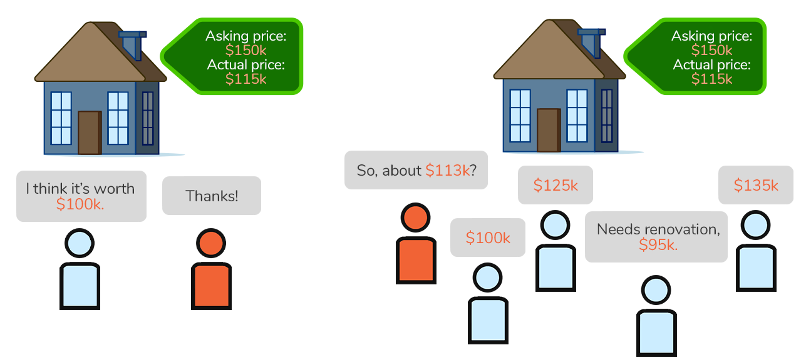

Slide 11
Code:
import pandas as pd
import numpy as np
import matplotlib.pyplot as plt
import seaborn as sns
from sklearn.model_selection
import train_test_splitfrom sklearn.preprocessing
import StandardScalerfrom sklearn.linear_model
import LinearRegressionfrom sklearn.tree
import DecisionTreeRegressorfrom sklearn.ensemble
import RandomForestRegressorfrom sklearn.metrics
import accuracy_score, mean_absolute_error, mean_squared_error, r2_score

Slide 12
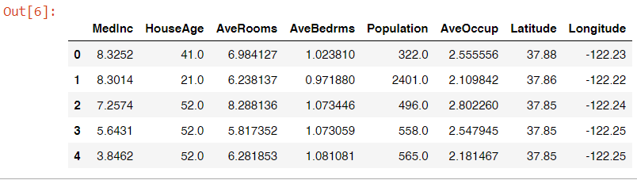
from sklearn.datasets import fetch_california_housing
housing_data = fetch_california_housing()
df = pd.DataFrame(housing_data.data)
df.columns = housing_data.feature_names
df.head()

Slide 13
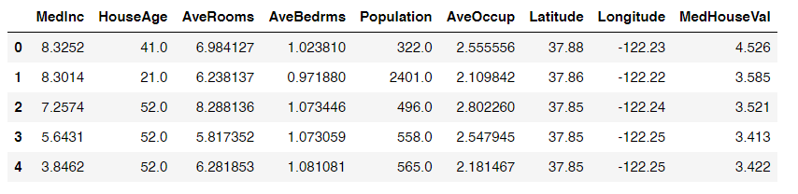
df['MedHouseVal'] = housing_data.target
df.head()

Slide 14
Conclusion :
Finally we conclude from our project is to determine the prediction of prices . In this we have discovered many algorithms and application of machine learning techniques with the objective of buying the real estate properties and to predict the worth in the future of the owned real estate properties.
References :
www.google.com
www.kaagle.com

Slide 15
THANK YOU…

